Slide 1

Adylkuzz Malware Overview
Brian Ascani
Jennifer Gibbs
Oscar Ortega
Ed Gomez
Peak Medical
Supplies

Slide 2

Introductions

Slide 3

Our Opportunity
Objectectives:
What is malware?
How did this happen?
Increasing security (awareness, training, etc.)
Understanding What makes us vulnerable
Risks to the organization
recommendations

Slide 4



What is Adylkuzz?
Malware: Cryptomining botnet
SHadow Brokers Hackers Group leaked an exploit created by the NSA
Exploit: EternalBlue
Affects windows 8 operating system & Window server 2008 (unpatched)
Uses smb protocol to mine Monero currency

Slide 5


What is Adylkuzz?
Made its debut in May 2017
Generated millions in Euros
Piggybacked off the vulnerability of eternalblue/doublepulsar
Operated undetected for several weeks
Made to execute undetected

Slide 6
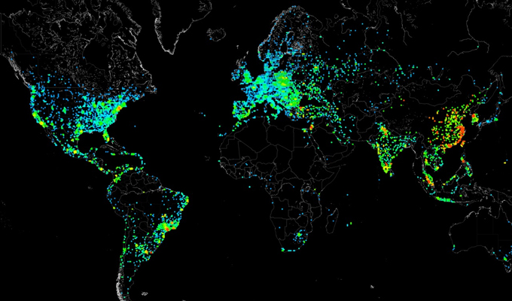
Adylkuzz: How does it work? PATCH
Scan internet for port 445
Use eternalblue to hack us.
Transfer adylkuzz.exe

Slide 7
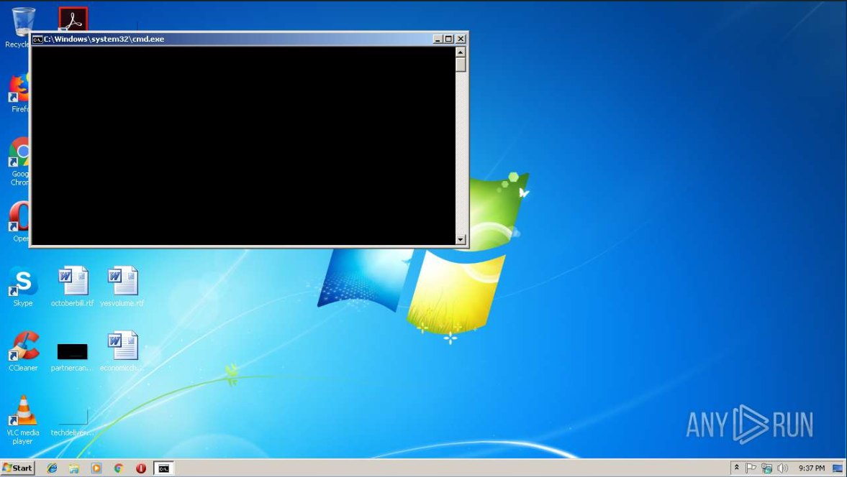
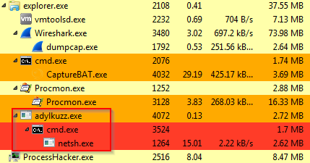
Adylkuzz: How does it work? And
Run CMD.exe
KILL PROCESSES
GATHER INFO
RUn netsh.exe
ADD FIREWALL RULES
BLOCK PORT 445

Slide 8
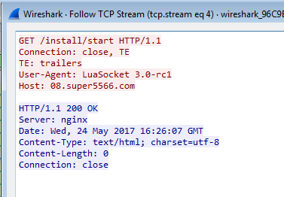
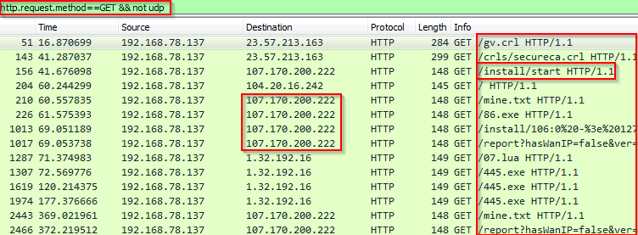
Adylkuzz: How does it work? UPDATE
CONNECT TO CNC SERVER
DOWNLOAD MINER
GET MORE INSTRUCTIONS

Slide 9
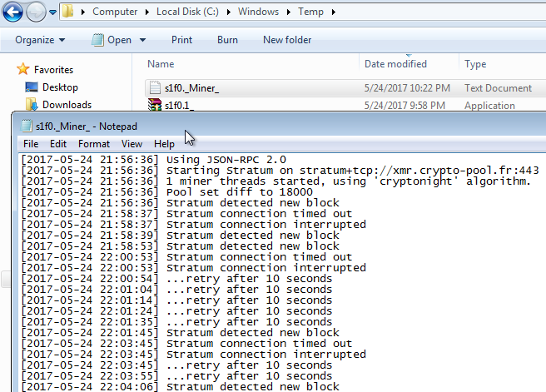
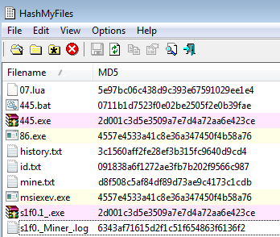
Adylkuzz: How does it work? YOUR
MINER LOG
VERIFY IT WORKS

Slide 10
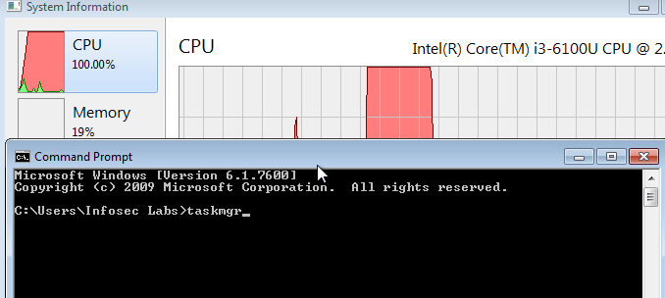
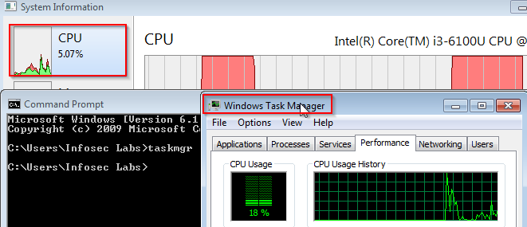
Adylkuzz: How does it work? SYSTEMS
TASK MANAGER OFF
100% CPU
TASK MANAGER ON
0% CPU
IF OFF, RERUN EVERY 1 MIN

Slide 11
Adylkuzz: Timeline
1
2
3
4
5
6
Executable file is created
Connection is made to a remote location
Remote location is used to prepare download
Cpuminer is downloaded
Remote connection is used to configure the download
Cpuminer is executed

Slide 12
Adylkuzz: Timeline ...Part 2
7
8
9
10
11
12
Access to port 445 is blocked
Services are created
Output log is generated and saved remotely
Processes are stopped once detected
Information is sent to a remote location
processes are checked and sent to remote location

Slide 13
Containment Strategy
Considered one of the most severe and Dangerous attacks:
The attack is launched from several virtual private servers which are constantly scanning over the internet; port 445 (TCP/iP)
Infects PC’s in the Server message block (SMB v1) which is launched from several virtual private servers;
Affected operating systems/services and versions: Any computer running windows xp / 10 or less ; it attacks more specifically Windows operating systems. Servers / Computers running Microsoft OS are specifically vulnerable.

Slide 14


Severity
it occupies your computer in order to mine for cryptocurrency; specifically bitcoin. The malware is installed without your knowledge; this type of ransomware does not ask for any type of money and does not lock any CPU’s internal data; however your computer will run slower and slower every day in order to mine for cryptocurrency (BItcoin / Monero).

Slide 15
How much damage the malware does to the infected computer (e.g., is it destroyed vs inaccessible vs just a little bit slower?)
Users will only Notice their Windows Machine is running slowly and that they don’t have access to shared Windows Resources. It is Unclear which Windows machine will be targeted or when.
How hard is it to remove without replacing the computer:
Need to scan computer to see if it is running slow. It is not locking up your data so one won’t be able to notify or identify such softwares.
is it just adware, or does it expose a full root shell to an attacker?
windows downloads money on your computer via the ransomware and then it transfers it to the attackers’ computer. There could be multiple Adylkuzz cryptocurrency servers. “Silently eating your computer” and they are only focused on mining for cryptocurrency, (Bitcoin; Monero).

Slide 16
Solution
Get patched against this smb vulnerability
You can also disable smb v1 (Microsoft Server Message Block on TCP 445
And what do we mean by TCP that is send or receive any data outside our network as we know there are many
keep up to date in your windows patching
keep up to date with your antivirus
make sure all of your signatures are up to date
majority of antivirus vendors do already have protection against this malware
use a firewall especially like a reputable one like blue coating in order to make sure that any traffic is being monitored, investigated, and appropriately blocked

Slide 17

Spread the Word
What You Can Do:
Report to IT immediately so they can begin to scan for any unauthorized use of the os hardware.
Generally, a trusted outside program could be used to immediately scan and terminate any suspicious programs running in the background.
Again, reporting to i.T. immediately could prevent any further damage (if any) from occurring on the systems hardware.

Slide 18

How to Identify Adylkuzz:
Signs you may have malware:
Msiexev.exe and wuauser.exe processes are running in Task Manager.
General slowness in os(i.e. Windows maximize and minimize slowly, games and videos running slowly as well).
All programs on current operating system running at a sudden and unprecedentedly slow rate.

Slide 19

Recommendations
Use firewall to block incoming connections from internet services that are publicly available
Enforce strict password policies
Ensure programs and users have the lowest privileges available to complete a task
Disable autoplay
Turn off file sharing if not need
Turn off or remove unnecessary services
Block access to threatened services until a patch is applied

Slide 20
Recommendations
Always keep patches up to date
Configure mail server to block or remove emails that contain attachments commonly used to spread threats
Isolate compromised computers
Train employees not to open attachments they are not expecting
Do not execute software from the internet that cannot be scanned for viruses
If bluetooth is not required, disable it

Slide 21

Summary
Peak Medical
Supplies

Slide 22

Questions?

